Slide 1

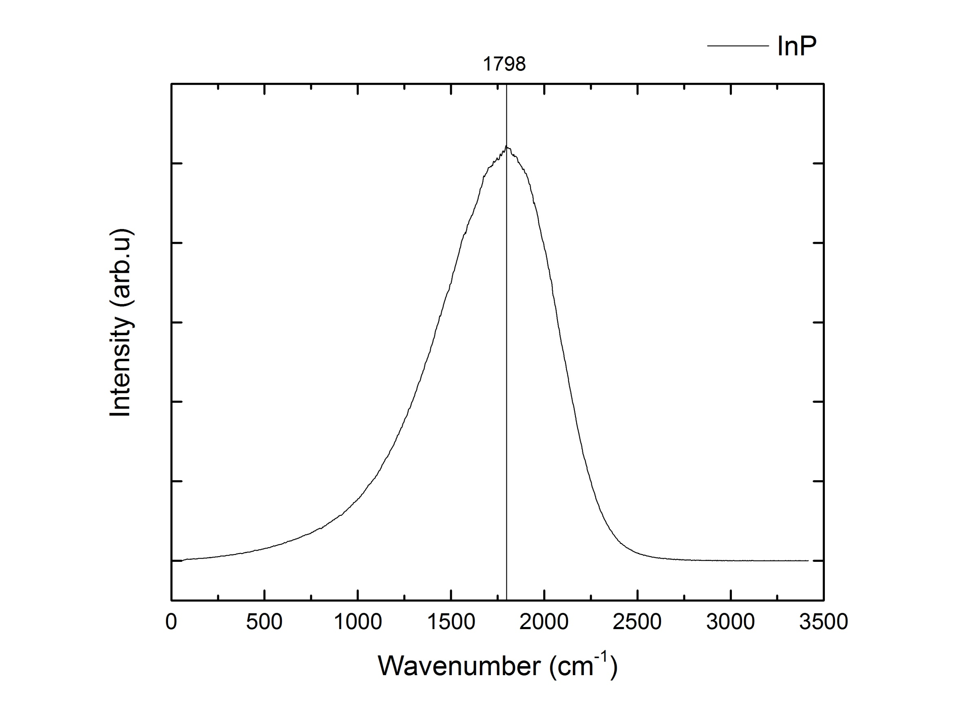
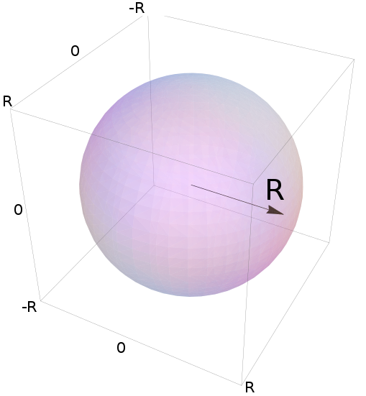
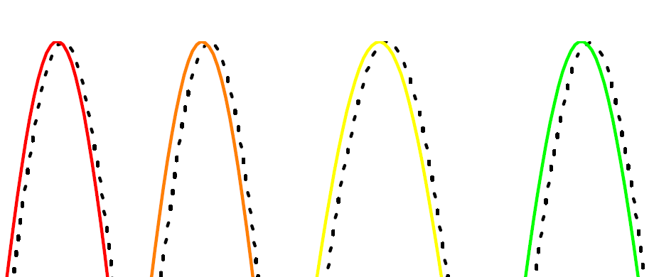
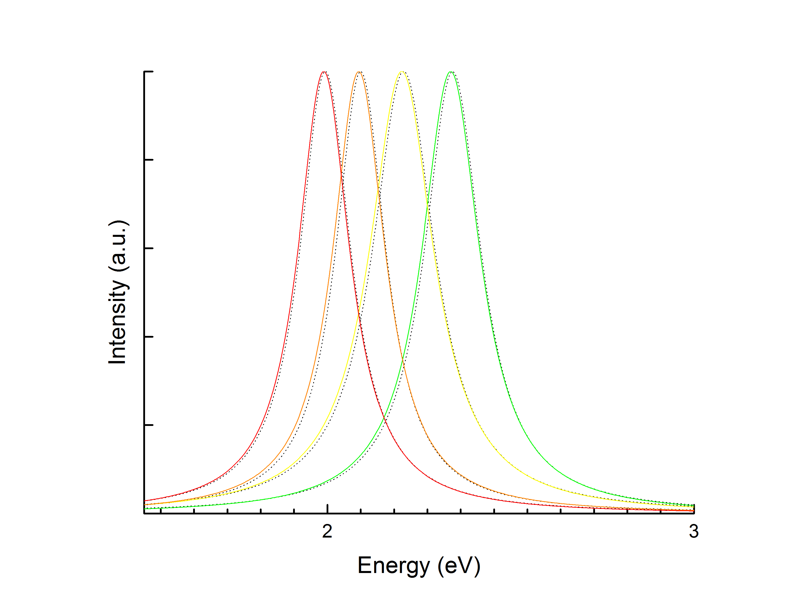
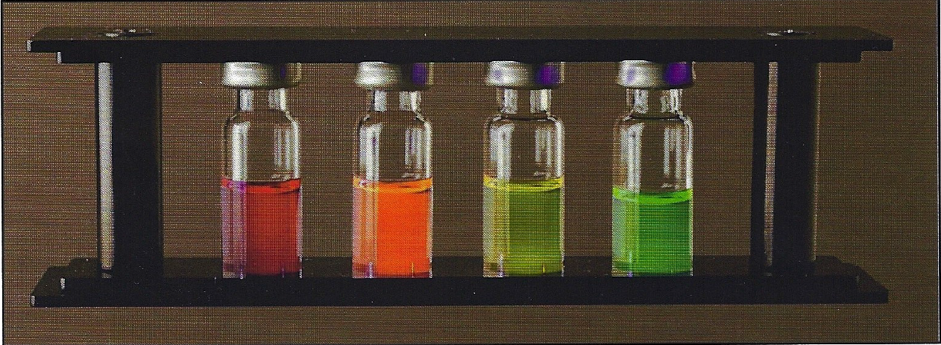
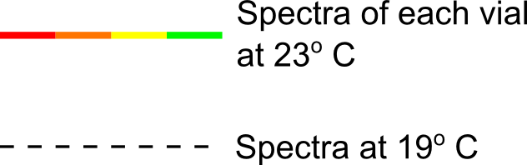
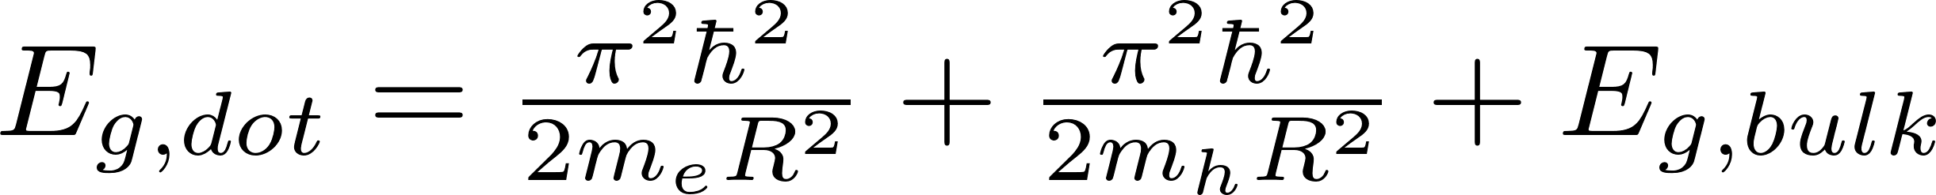
Determining the Radii of Quantum Dots Using Photoluminescence Spectroscopy and the Schrödinger Equation
Eric Nelson, Vaman M. Naik, Jim Hetrick
Department of Natural Sciences, University of Michigan-Dearborn
Abstract
Conduction Band
Results
Discussion
The radii of semiconductor quantum dots were estimated indirectly by using photoluminescence spectroscopy to determine their band gap energies. The quantum dot samples were InP nano-sized crystals suspended in solution, sorted by size by the manufacturer into four separate vials. Samples were excited with 405 nm radiation and the spectrum of their visible fluorescence was recorded. Using the Schrödinger equation and a particle-in-a-box model their radii were estimated based on the difference between the measured band gap energy and InP’s bulk band gap arising from quantum confinement. The measured radii ranged from 2.31 ± 0.2 nm for dots exhibiting green emission, to 2.87 ± 0.1 nm for ones exhibiting red emission. Results were within 2% of the manufacturer reported values. The spectra below room temperature were also recorded, showing a slight band gap energy increase at the lower temperature.
As the radius of a quantum dot increases, the band gap of the dot decreases. Additionally, at cooler temperatures, the band gap energy for a quantum dot increases. This means that the wavelength gets blue-shifted at lower temperatures. The bulk band gap for a material also increases as temperature decreases. There is some discrepancy between our value for the bulk band gap on InP and the expected value of 1.351 eV,² which is likely due to the purity of our sample that we used for spectroscopy.
The study of a material’s band gap is an important topic in solid state physics and the study of semiconductors. As temperature decreases, a semiconductor becomes more resistive. This is in opposition to a regular conductive metal, where as temperature decreases, resistivity decreases. These give semiconductors a unique property that make them essential in electronics.
ENERGY
Band gap energy
Valence Band
Figure 2: The band gap energy for a semiconductor is shown above. The larger the band gap energy, the more energy required to excite electrons from the valence band to the conduction band, where they are free to move as charge carriers
Figure 4: The Raman spectrum of bulk InP. The peak wavenumber was used to calculate E_{g,bulk} for the semiconductor material.
Theory
Methodology
The quantum dots can be represented by the particle-in-a-box model from quantum mechanics, seen in Fig. (1)
We calculated the band gap energy from the Raman spectrum (Fig. 4) to be 1.342 eV, which is the value we used in our calculation to find the radius.
Conclusions
We had four separate vials that we obtained from the Cenco company, each containing differently sized InP quantum dots of unknown radius. We beamed 405 nm UV light on each sample while taking a spectrum.
×6
The quantum dot is an excellent example showing the application of the famous particle in a box problem in quantum mechanics. By treating a quantum dot as the box, and the electron and electron hole as particles in the box, one can solve for the width of the quantum dot. This is achieved by using photoluminescence spectroscopy to determine the band gap of the quantum dots in conjunction with the Schrödinger equation. Using this method, we were able to determine values for four differently sized InP quantum dots with less than 2.1% error. We also confirmed the band gap energy of InP as 1.342 eV, which is within 0.7% of the actual value of 1.351 eV.² Additionally, we explored the effects of cooling quantum dots and determined that it raises the band gap of the material.
1
2
3
4
 | 23º C
 | Wavelength (nm) | Energy (eV)
1 | 624 | 1.98
2 | 585 | 2.08
3 | 564 | 2.19
4 | 531 | 2.33
Figure 3: The image of the four different vials. They emit light in different optical wavelengths, depending on the size of the quantum dot, when excited with UV light. The quantum dots absorb the energy from the UV light and re-emit it. This phenomena is known as photoluminescence. Image taken from reference [1]
Figure 1: Schematic of the particle-in-a-box problem. The purple sphere is the quantum dot centered at the origin of the box. The “box” goes from –R to +R, where R is the radius of the quantum dot, and the “particles” are electrons and electron holes.
Figure 5: These peaks represent the best fit Lorentzian and normalized photoluminescence spectra for the four different vials. The peak energy was used for E_{g,dot} in our calculations. The cooler spectra are shifted to the right.
References
[1] Cenco and Nanosys, Operating Instructions 175118 Cenco Quantum Dots
[2] Varshni, Y.P., Physica, (34), 1967
The model starts with a derivation from the Schrödinger equation, which can be solved for the radius, R:
Depending on the particle size, a different color light was emitted in the visible spectrum: green, yellow, orange, and red, seen in Fig. (3). The wavelength at maximum (or peak) intensity was converted into energy and used to solve for the radius. We conducted this experiment for the vials at room temperature (23º C) and at 19º C.
We also calculated the bulk band gap energy for InP using Raman spectroscopy. We took the Raman spectrum of a 1 cm² piece of InP and converted the peak value into energy.
We calculated the radii of the semiconductor quantum dots in each vial using the energies obtained from Fig. (5). The radii are given in the table below, and are compared to the values given by the manufacturer.
Acknowledgments
Color | Experimental Radius (nm) | Radius by Manufacturer (nm) | Percent Error (%)
Red | 2.87 ± 0.13 | 2.92 | 1.72
Orange | 2.68 ± 0.18 | 2.72 | 1.31
Yellow | 2.49 ± 0.23 | 2.53 | 1.29
Green | 2.31 ± 0.19 | 2.37 | 2.04
Special thanks to Dr. Vaman M. Naik and Dr. Jim Hetrick for their guidance and considerable knowledge on the subject matter of spectroscopy and semiconductors.
Where ħ is Planck’s constant, m_{e} and m_{h} are the electron and electron hole masses, respectively, E_{g,bulk} is the band gap energy for bulk InP, and E_{g,dot} is the band gap energy of a quantum dot, obtained from our photoluminescence spectroscopy. The band gap for a semiconductor is illustrated in Fig. (2).
Notes:
1

